Slide 1
Framework Design

Slide 2
Agenda
What is Framework
Need of Framework
Types Of Framework
Page Objet Model
Hybrid Framework development

Slide 3
What is Framework
A framework is a set of assumptions, concepts and practices that needs to be followed.
It is nothing but a set of guidelines
These guidelines consist of coding standards, test-data handling, object repository treatment etc.
It is up to you whether to follow these guidelines while automating script.
However, it is always beneficial to follow these guidelines in order to produce effective outcomes such as increase code re-usage, higher portability, reduced script maintenance cost etc.

Slide 4
Need of Framework
The initial requirement of having a standard way of writing tests is what will evolve into a framework.
Every company or teams can have different frameworks but the whole idea will be to have a common set of rules.
Without a framework in place, there will be one test case which will comprise the entire test functionality.
Because of multiple line of code a test case so huge will be tough to read.
Even if you want to modify any functionality later, then you will have a tough time modifying the code.
Since the implementation of a framework, will result in smaller but multiple code pieces, there are various benefits.

Slide 5
Benefits of Framework
Increased code reusability
Improved code readability
Higher portability
Reduced script maintenance

Slide 6
Hybrid Driven Framework
The best thing about such a setup is that it leverages the benefits of all kinds of associated frameworks.
Hybrid framework is a technique wherein we can make the best use of both Data-Driven and Keyword-Driven Testing Framework.
For specification, it uses the data files to contain the keywords related to the application being tested. These keywords describe the set of actions that are required to perform a specific step. And sets of test data can be stored in the same data file or another source (Exel, CSV, JSON, database, ...).

Slide 7
Hybrid Framework
1
Page Objects
6
TestNG.xml
4
Maven
Test Cases
Base Class
2
Utilities
5
7
Jenkins
POM.xml
3
Config files
Reports

Slide 8
Design Pattern
Design patterns are used extensively when programming and they generally offer a reusable solution to a known occurring problem.
In many respects, the introduce a set of best practices into your code and usually result in more flexible and maintainable code.
Design patterns are used to build different parts of the frameworks
Design patterns are smaller architectural elements than frameworks.
A typical framework contains several design patterns, but the reverse is never true
Framework can be reused directly whereas Design patterns are project specific

Slide 9
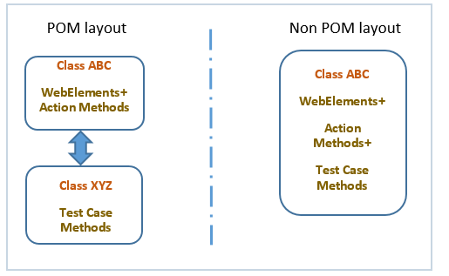
Page Object Model
Page Object is a Design Pattern which has become popular in test automation for enhancing test maintenance and reducing code duplication.
A page object is an object-oriented class that serves as an interface to a page of your AUT.
Every web page in the application should have a corresponding page class.

Slide 10
Page Object Model
Page Object is a class that represents a web page and hold the functionality and members.
This Page class will find the WebElements and also may contain page methods which perform operations on those WebElements.
Advantages
Makes our code cleaner and easy to understand - keeps our tests and element locators separately
Easy to visualize each step of the scenario, view and edit test cases intuitively
POM approach makes framework programmer friendly, more durable and comprehensive
Any UI change can easily be implemented, updated and maintained into the Page Objects and Classes
Re-usability of code - object repository is independent of test cases

Slide 11
Ways for POM
1.Using normal approach (By)
public class Login
{
WebDriver driver;
public Login(WebDriver driver)
{
this.driver=driver;
}
By uname=By.xpath(“”)
public void enterUsername()
{
driver.findElement(uname).sendKeys(“”) } }
Test Case
Login l1=new Login(WebDriver driver);

Slide 12
PageFactory
Page Factory is a class provided by Selenium WebDriver to support Page Object Design patterns. In Page Factory, testers use @FindBy annotation.
The initElements method is used to initialize web elements. initElements is a static method in Page Factory class. Using the initElements method, one can initialize all the web elements located by @FindBy annotation.
@FindBy: An annotation used in Page Factory to locate and declare web elements using different locators. Below is an example of declaring an element using @FindBy.
Syntax:
@FindBy(id="elementId") WebElement element;
Or
@FindBy(how=HOW.ID,using=“elementId”)
WebElement element;

Slide 13
2.Using Page Factory class(@FindBy)
public class Login
{
WebDriver driver;
public Login(WebDriver driver)
{
this.driver=driver;
}
@FindBy()id=“txtusername”
WebElement username
public void enterUsername()
{
username.secnKeys(“Admin”); }
}
Test Case
Using PageFactory within test
LoginPage page = PageFactory.intElements(driver,LoginPage.class)

Slide 14
Steps to Design Framework
Step1:SetupProject
1.Create Maven Project
2.Update pom.xml
3.Create folder structure(reports,screenshot,xmlfile, test data, config)
4.Create package(pages,testcases,utility)
Step2:Create POM and TestCase
5.Create Page Objects
6.Create Basic Test case
Step3:Create Dataprovider & libraries for the framework
7.Read common values from properties file
8.Create Data Driven test case
9.Run test case on desired browser
Step4:Add Reports& logs to framework
10.Add extent report
Step5: Execution of Framework
11.Run Using maven & Jenkins

Slide 15
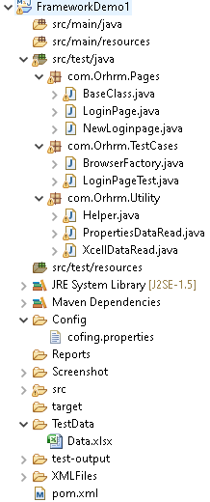
Folder structure

